Slide 1
SQLite Internals
오기환
(wurikiji@gmail.com)
SKKU VLDB Lab. (27334)

Slide 2
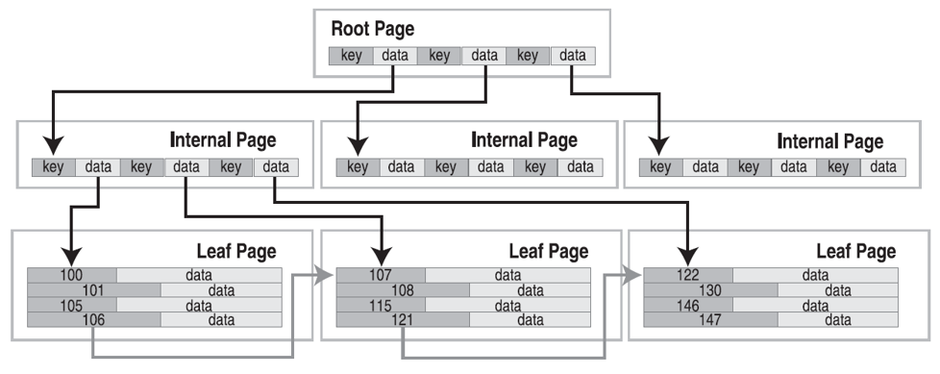
B+tree Internals in SQLite - 1/2

Slide 3
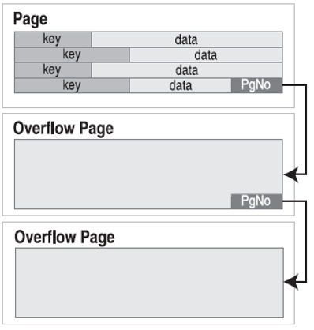
B+tree Internals in SQLite - 2/2

Slide 4
Page structure
File Header
First page only has 100 bytes
Page Header
8 bytes for leaves
12 bytes for interiors
Cell
Real data
File Header
Page Header
Cell Pointers
Free Space
Cell Contents

Slide 5
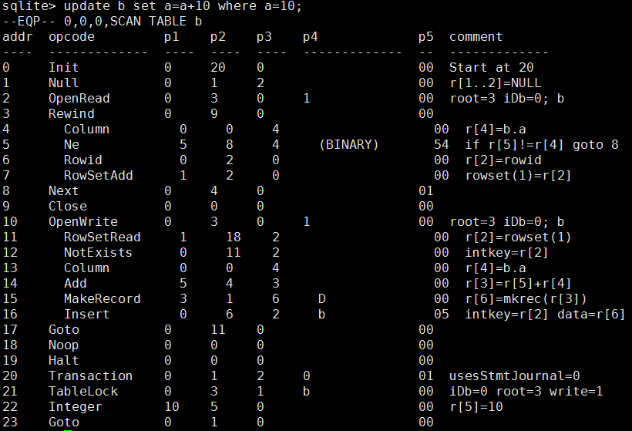
Update OP code

Slide 6
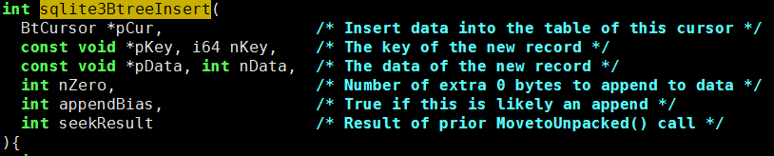
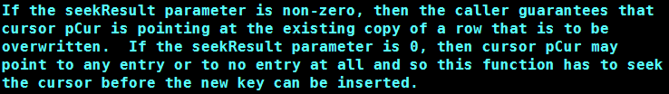
sqlite3BtreeInsert
Insert/Update

Slide 7
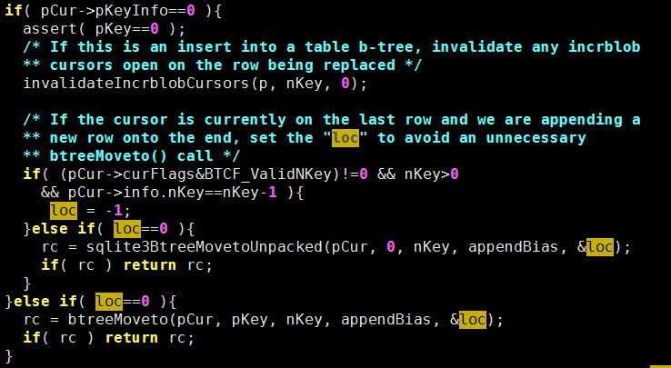
sqlite3BtreeInsert
Move to location

Slide 8
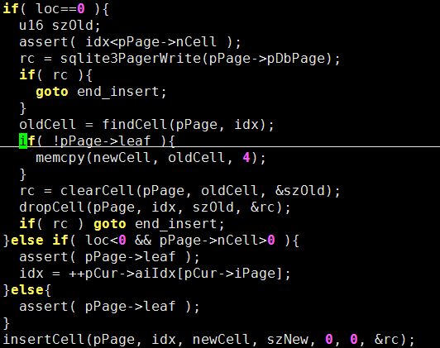
sqlite3BtreeInsert
Make record to cell and insert into page

Slide 9
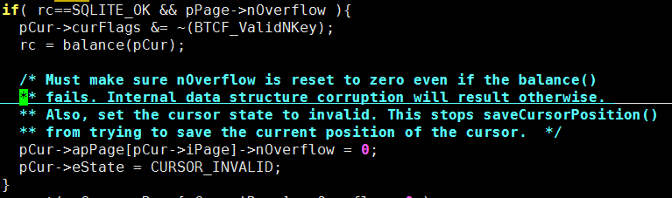
sqlite3BtreeInsert
Balance a tree

Slide 10
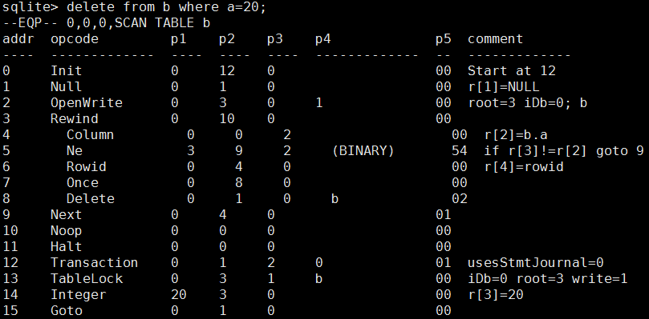
Delete OP Code

Slide 11

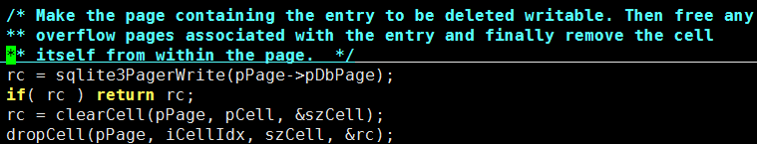
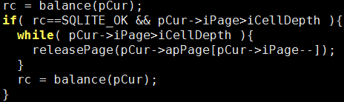
sqlite3BtreeDelete

Slide 12
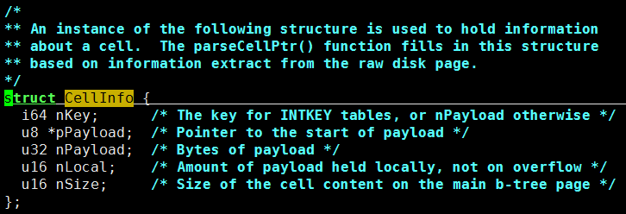
Cell Information Structure

Slide 13
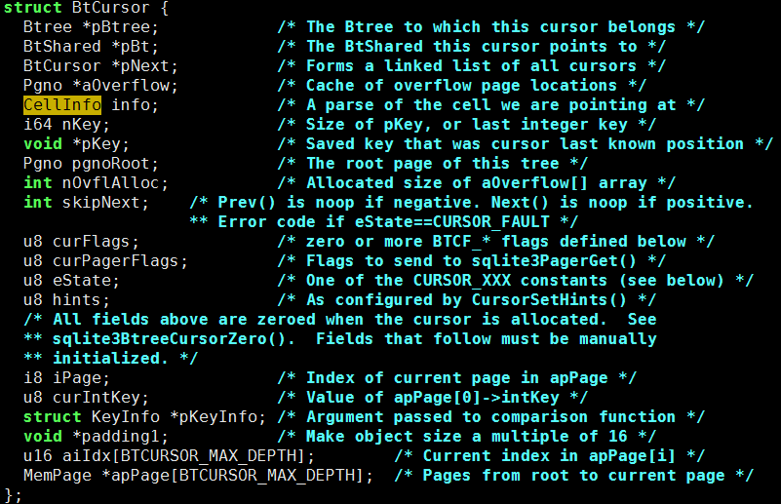
Btree Cursor Structure

